Slide 1

STEM Fair Information
(sample)
Elementary School

Slide 2
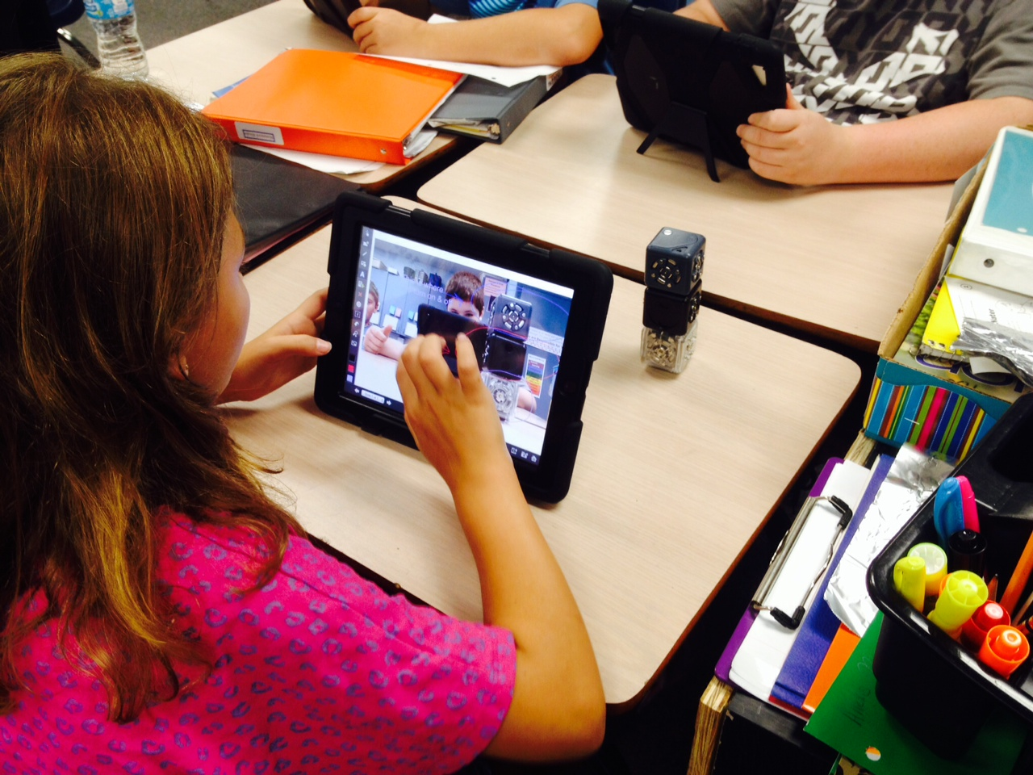
What is STEM?
Science
Technology
Engineering
Mathematics

Slide 3
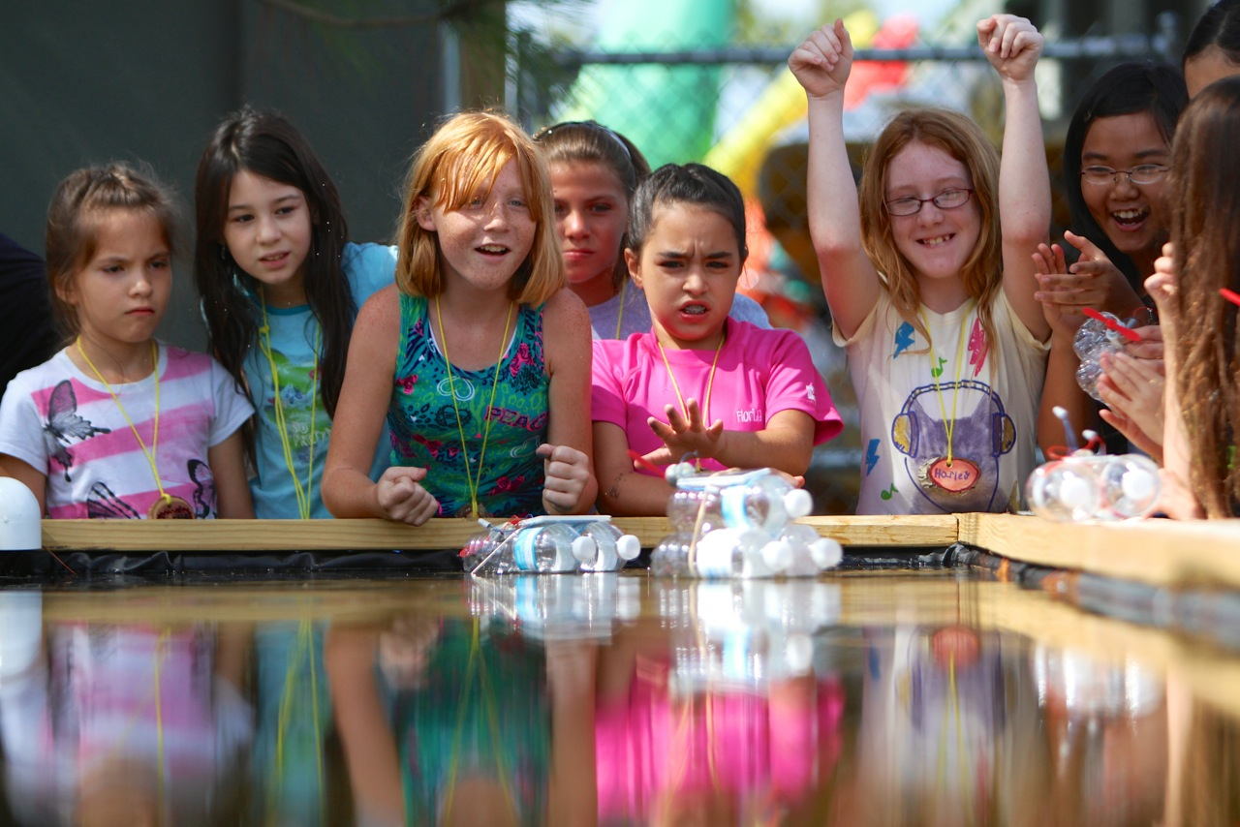
Why a STEM Fair?
Providing students opportunities to make meaningful connections to the real world is critical as we develop the skills, behaviors, and dispositions necessary for college, career, and life readiness.
Developing a S.T.E.M. (Science, Technology, Engineering, and Mathematics) Fair investigation will provide students the opportunity to use science knowledge and skills just as scientists do in the real world.

Slide 4
Skills used in STEM Fair include:
Writing clearly
Communicating information effectively
Collecting and interpreting data
Using evidence to justify your thinking
Managing time
Providing opportunities to ask “why” leading to the development of an experiment or designing of a solution/innovation

Slide 5
Supporting your child with STEM Fair
Parents play a critical role in supporting their child throughout the STEM Fair process.
Be interested, encouraging and positive
Supervise and use resources that ensure the SAFETY of both your child and tested organisms.

Slide 6
Try to ask questions rather than give answers:
Questions help place responsibility on your child.
Questions help explore the dimensions of the problem.
Questions draw solutions from your child.
Questions communicate trust and confidence.
Questions help develop your child’s thinking and problem solving skills.

Slide 7
Sample Guiding Questions:
Why?
How do you know that?
What do you want to happen?
What would happen if…?
What other things could you try?
Explain or assist in finding resources to explain concepts that are difficult to understand.

Slide 8
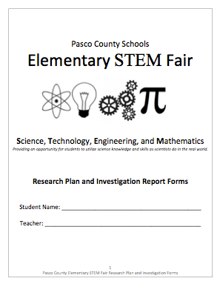
Research Plan
Provides clarification and guidance throughout your child’s investigations.
Helps your child stay organized
Your child MAY need to keep an ADDITIONAL project log or journal. This could include dates and notes of everything that is done and read in connection to the investigation.

Slide 9
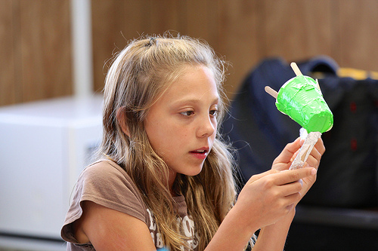
Getting Started: Choosing an Investigation
Your child needs to be excited about their investigation, guide them to investigate something they are interested in.
Research: Your child needs to gather information to help them develop their investigation

Slide 10
Example Question/Problem
Problem I am going to solve: “I am constantly losing things out of my pant pockets. How can I create a pant pocket that keeps items inside?”
  This investigation has the student design/engineer something and then test it to help them solve their problem.
Question I am going to answer: “Which brand of diaper is the most absorbent?”
Notes:
Notice: This question is a good question which would allow students to go through the scientific process manipulating only one variable; the type of diaper.
This problem would allow the student to design a solution and test its effectiveness.

Slide 11
Example Hypotheses
Question: If I put 30 mL of water in the Huggies diaper, then it will absorb the most water because Huggies diapers have an extra layer of polyfiber material.
Problem: If I create a magnetic pocket casing, then I will lose fewer items out of my pockets because magnets provide a tight seal due to their characteristics.

Slide 12
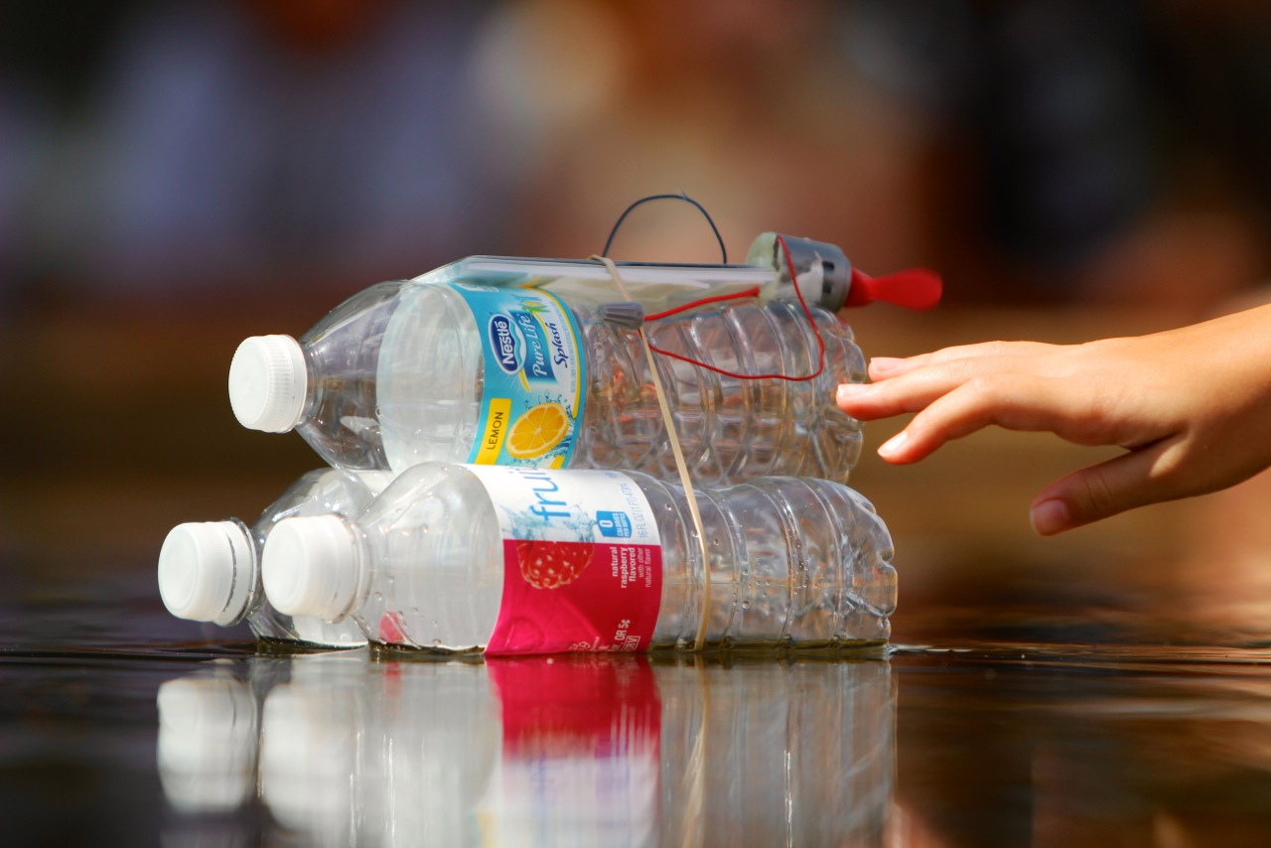
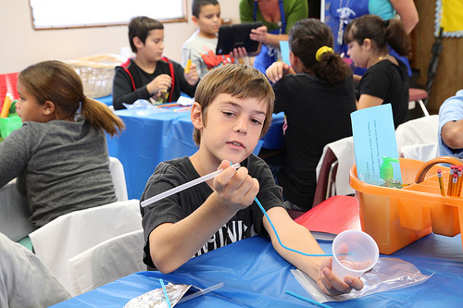
Putting It Into Action: Procedure
The purpose of the procedure is so other scientists and engineers can replicate your investigation. DETAIL, DETAIL, DETAIL.
Make sure to share all steps completed during the investigation and/or design of the solution.
It is okay if you begin your procedure and realize you may need to change something. This happens to scientists and engineers all the time.

Slide 13
Variables
A variable is a fancy word for things that you will be changing or keeping the same throughout your investigation. There are 3 types of variables:
Independent: The variable that will be changed
Dependent: The variable that will show an effect
Constants: All the things that will be kept the same throughout the investigation to make sure it’s valid

Slide 14
Example Variables for Diaper Question
Independent: different brand of diapers that are being tested (Huggies, Pampers, Luvs)
Dependent: the amount of water absorbed (measuring using mL) by each brand of diaper
Constants: temperature of the water, location in the diaper in which water is poured

Slide 15
Example Variables for
Pant Pocket Problem
Independent: different types of materials tested to create the pocket casing
Dependent: the number of shakes the pant pocket can withstand before losing its contents
Constants: same pair of pants and sized pocket, same items placed in the pocket casing

Slide 16
Collecting Data
As you investigate your problem be sure to collect data using a chart or table in your log or plan book
This will help you draw conclusions when you are finished with your experiment

Slide 17
Graphing Results:
Communicating Our Data
Types of Graphs:
Bar- Compares different things
Line- Shows progress over time
Circle- Parts of a Whole
Make sure title and subtitles are labeled.
Number of paper towels
Number of Ounces Absorbed

Slide 18
Conclusion and Abstract:
Putting It All Together
What did you learn from the experiment?
Did you prove your hypothesis?
    Why-why not?
What problems did you have?
How is it applicable to real life?
What can the results be used for?
How can I use the knowledge I have gained from the experiment?
What would you do differently next time?

Slide 19
Safety and Display
The following items are not permitted to be displayed with your backboard:
  Any glassware including containers that contain liquids
  Any sharp items or edges. These could be hazardous to other students
  Open flames or anything combustible
  Mold regardless if it is in a container (Take Pictures)
  No food (human or animal)
  There will not be any electricity provided

Slide 20
Pasco County Elementary School
S.T.E.M. Fair
Who: Representatives from each elementary school (Grades 3-5)
When: Saturday, April 26, 2014
Where: River Ridge Middle/High School Complex

