Slide 1
Welcome to Open House
Seven Springs Elementary-Where children are loved, kept safe, and learn at high levels

Slide 2
The Superintendent’s
Welcome Back
message
https://www.youtube.com/watch?v=ZpqbNwlYp30&feature=youtu.be

Slide 3
Title I Information
Review our Title I pamphlet
Please sign the Family Compact – Family involvement is key
Consider becoming a volunteer!
Join us September 26 from 6-8 p.m. for our Title I and Math night!

Slide 4
Volunteer Information
Register on our website to be an approved volunteer!
It is quick and easy.
Be approved to volunteer on campus, help on field trips, etc.
Vote on SAC Membership

Slide 5
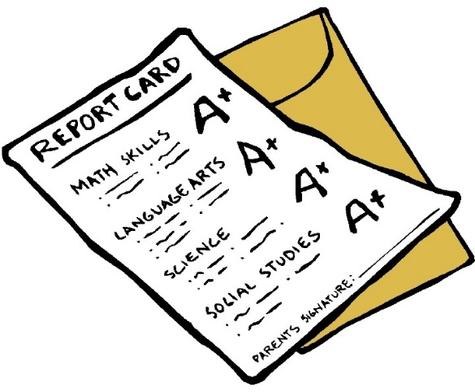
Parent/Teacher Conference
Please sign up for a parent-teacher conference!
Knowing how your child is progressing and how to assist at home is so important

Slide 6
A few Reminders:
When visiting campus, please sign in the front office with a photo ID.
Additional family resources located in the front office
Join us on Facebook to see what’s happening
Check our school’s website
Remember, arrival time 9:25 and tardy is 9:40
Free breakfast is provided every morning
If needed, complete a free and reduced lunch application

Slide 7
join us for family events! See our Title I information pamphlet
Visit our Book Fair and PTO in the Media Center TONIGHT!.
Activity Date/s |  | Activiity Date/s
PTO Bingo Title I/Math Night Reading Night (IRLA) Red Ribbon Week PTO Fall Festival Great American Teach-In STEM Night PTO Winter Wonderland & Chorus PTO Movie Night FSA Night | September 15, 2017 September 26, 2017 October 19, 2017 October 23-27, 2017 October 27, 2017 November 15, 2017 November 30, 2017 December 15, 2017 January 18, 2018 January 30, 2018 | PTO Valentine’s Dance Field Day PTO Bingo Night Volunteer Breakfast Intermediate Spring Musical Primary Spring Musical Fifth and K Graduations McShark Nights School Advisory Council | February 09, 2018 March 15, 2018 February 12, 2018 May 10, 2018 May 10, 2018 May 15, 2018 May 25, 2018 Monthly Monthly

Slide 8
curriculum
MATH NIGHT
September 26th at 6:30 – 8:00 p.m.
Free dinner from 6:00-6:30
Visit: greatminds.org for more information about Eureka
READING NIGHT
October 19th from 6:30 – 8:00 p.m
Find out more about IRLA
Ensure your child is reading for 30 minutes daily.

Slide 9
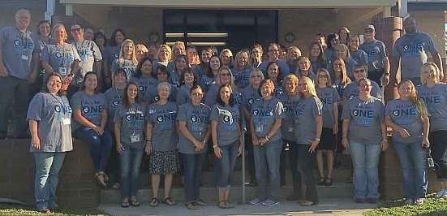
Thank you!
For being your child’s First and Most Important Teacher!

Slide 10
My Information
Email address -
How to contact you
etc

Slide 11
Schedule
Your schedule here

Slide 12
Classroom Tidbits
Expectations (e.g., Snack, supplies, ladder system, recess, signed planner, etc.)
Fun facts

